Slide 1

Family Safety App
Minor Project
Pratham Bajpai
(0901EO211043)
Under Guidance
Dr. Saurabh Kumar Rajput

Slide 2

INTRODUCTION
The Family Safety App aims to address the growing concerns surrounding the safety and security of family members.
The app provides families with the means to stay connected and informed in real-time.

Slide 3
METHODOLOGY
Requirement Analysis (Key Features and Functionalities)
1
Design Phase
2
User Interface Design
System Architecture
Development
3
Frontend Development
Backend Development
Integration of Third-Party Services
Testing and Quality Assurance
4
Unit Testing
Integration Testing
User Acceptance Testing
Deployment
5
Release Planning
App Store Submission
Maintenance and Updates
6
Continuous Monitoring
Feature Enhancements

Slide 4

SOFTWARES/TOOLS
Android Studio
Firebase RealTime Database
Cloud FireStore
Room Database
Google Services
Third-Party Libraries and SDKs

Slide 5
Generate good short answers for Result & Discussion slide - Present your findings and their significance.
Several applications offer individual features like location tracking or SOS alerts, there's a noticeable gap in the market for a comprehensive solution that integrates all essential functionalities seamlessly.
Our project addresses this gap by combining various features into a single platform, offering families a holistic approach to safety and communication:
Location Tracking
Communication capabilities
Emergency Assistance (SoS Alerts)
Family Member Management (with accept and deny)
Google Map Feature
Battery Information
Wi-fi Connectivity
FINDINGS

Slide 6
PROJECT OUTCOMES
Key Achievements
Battery Information
Wifi Connectivity
Video Calling Feature
Enable Chatting Feature
Geofencing and Safe Zones
Finding Nearby Places (Hospital, Police Station)

Slide 7
AI-Powered Safety Recommendations
Family Health Monitoring
Smart Home Integration
Crowdsourced Safety Alerts
Family Activity Planning
FUTURE EXPANSION

Slide 8
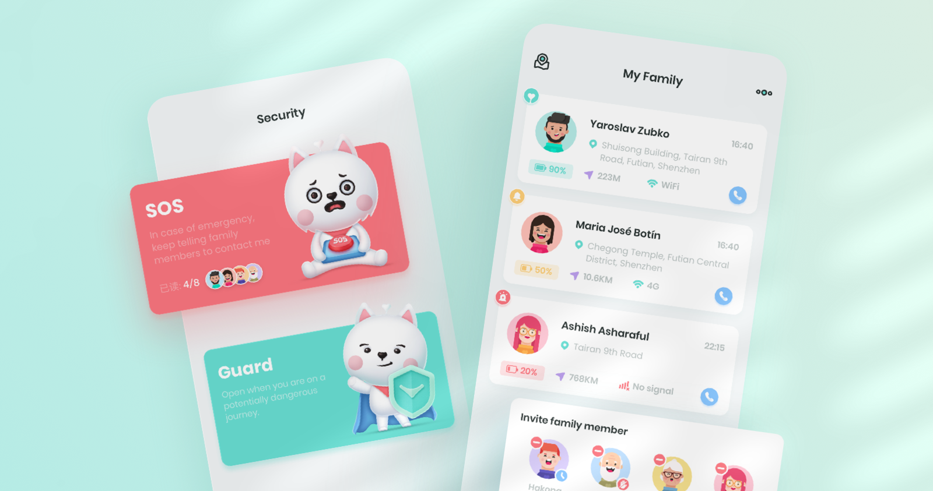

Slide 9
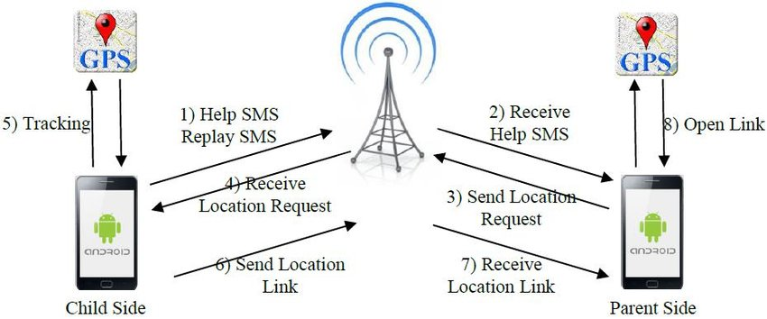

Slide 10

THANKYOU

